Slide 1

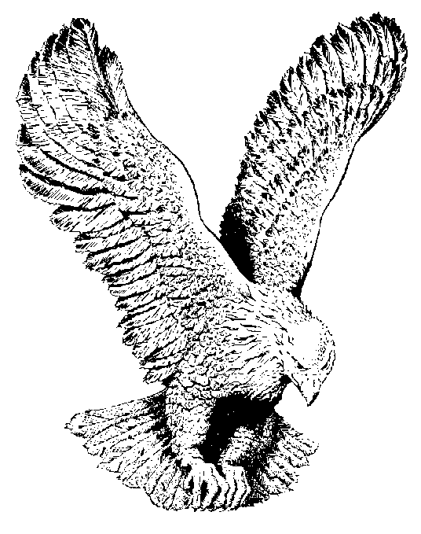
769 ART THOU WEARY
Art thou weary, art thou languid,
Art thou sore distressed?
“Come to me,” saith One, “and coming, Be at rest.”

Slide 2
Hath He diadem as a monarch,
That His brow adorns?
Yes, a crown of very surety,
But of thorns.

Slide 3
If I ask Him to receive me,
Will He say me nay?
Not till earth, and not till heaven,
Pass away.

Slide 4
Finding, following, keeping, struggling,
Is He sure to bless?
Angels, martyrs, saints, and prophets
Answer, “Yes!”

